Slide 1
AVL Trees, B Trees, 2,3,4-Trees & Red-Black Trees
Lecture at CSE Dept. PDEU
17th October, 2023
Rahul Muthu
Associate Professor
Dhirubhai Ambani Institute of Information &Communication Technology (DA-IICT)

Slide 2
Linear Data structures for Sorted Data
We look at linear data structures to store aggregate data of identical data type, sorted (in increasing order; or non-decreasing order if we assume distinct keys)
The main operations in this content are insert, deletes, search.
The main advantage of this type of organisation is its simplicity
The obvious disadvantage is that insertion, deletion and search, as also other related operations, take time θ(n) in the worst case, where n is the number of data records present. This despite the data being sorted.
This is overcome to some extent via the data structure called Binary Search Trees (BSTs)

Slide 3
Binary Search Trees (BSTs)
BSTs perform insertion, deletion, search, min, max, successor, predecessor and several other operations involving a specific node related attribute in time ϴ(h) in the worst case, where h is the height of the tree when the operation is performed.
We have to emphasise the time when the operation is performed, because we are dealing with dynamic data sets which change their attributes with time.
The performance measures mentioned above are satisfactory, and likely best possible, in the event of well balanced trees. This is the major improvement over linear lists.
This is because the data is sorted along different linear strands (root-to-leaf paths), with nice conditions, typically requiring us not to traverse more than one strand in one operation.
Since the same data that is present in a single strand in a linear list is distributed across several strands in BSTs, it is clear that there will be some reduction in the length of the list to be processed.
The disadvantage is that, sometimes (maybe often), the height of a binary search tree is close to the number of data items stored in it. This renders its performance no better than that of a linear list

Slide 4
Heights & Depths of nodes
The height of a node in a tree is the number of edges on a longest path from that node to a descendant leaf of that node.
Mathematially, the height of an empty node or null node is defined as -1
The height of a leaf node is defined as 0
For all other nodes, the height is defined recursively as 1+Max{h(left-child),h(right-child)}
The height of a tree is the height of its root node.
The depth of a node is the number of edges in the pathe from the root to that node.
The depth of the root is 0. The depth of any other node is the depth of its parent +1

Slide 5
AVL Trees
Named after Georgy Adelson-Velsky and Evgenii Landis (Soviet Union inventors of the data structure).
Defined recursively/ inductively. Base cases:
Empty / zero node BST; height is defined as -1
One node BST; height is defined as 0
The inductive step is, a BST on two or more nodes is called AVL if
Its left subtree is AVL
Its right subtree is AVL
The height difference between left and right subtrees is either -1, 0 or +1

Slide 6
Rotation (algorithm used to balance the height of a BST)
Algorithm 1:Left-Rotate (T, x)
y ← right[x]
π(y) ← π(x)
right[x] ← left[y]
if left[y] != ∅
then π(left[y]) ← x
if π[x] = ∅
then ROOT[T] ← y
else if x = left[π[x]]
then left[π[x]] ← y
else right[π[x]] ← y
left[y] ← x
π(x) ← y
The running time of this algorithm is O(1). Observe that changing the structure of the tree here involves reassigning the links associated with the neighbors of x and y.

Slide 7
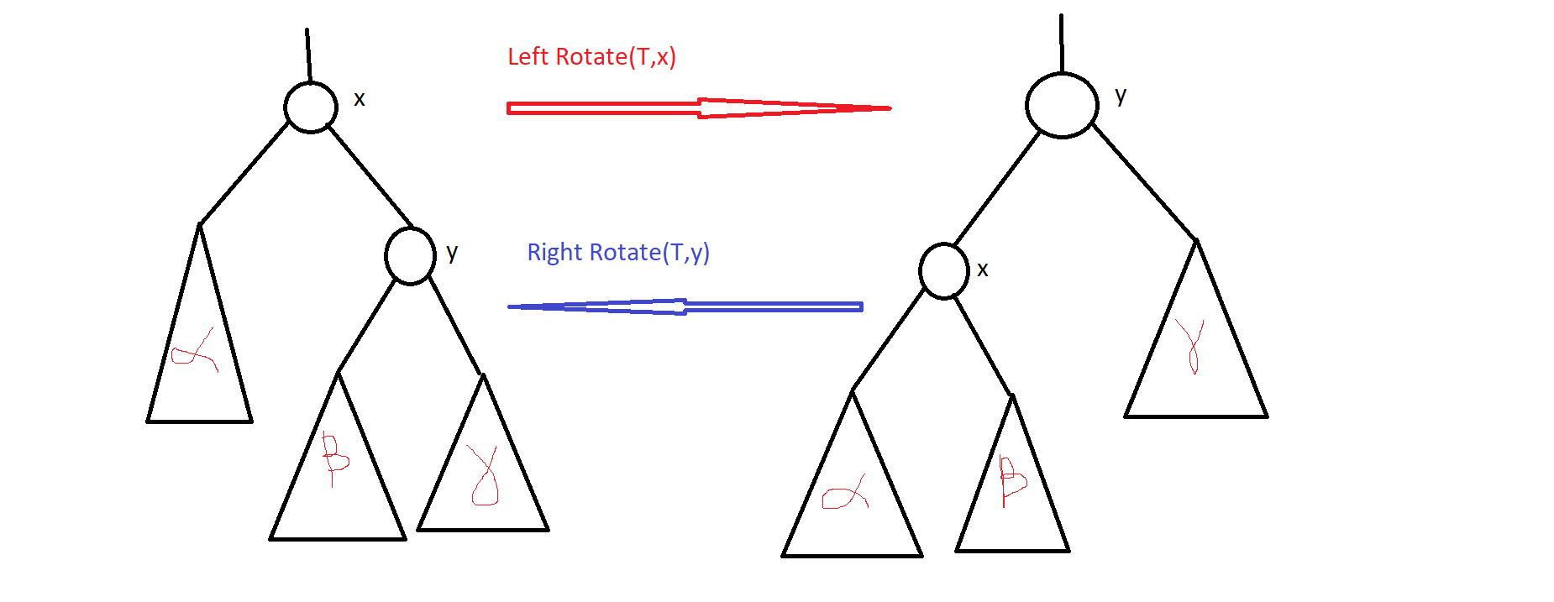
Demo of Rotation

Slide 8
Heights change during rotation
The subtree on the left is rooted at x, and the one on the right is rooted at y. Let us calculate the formula for the subtree on the left and on the right.
H_{l} = Max{h(α),h(y) } +1
=Max{h(α), Max{h(β),h(γ)}+1}+1
= Max{h(α) }+1, h(β)+2,h(γ)+2}
Similarly,
H₂ = Max{h(α)+2, h(β)+2,h(γ)+1}

Slide 9
Questions
What is the maximum number of nodes in a height h AVL tree?
What is the minimum number of nodes in a height h AVL tree?
What is the min and max height of an n node AVL tree
What is the smallest possible leaf depth in a height h AVL tree?
Can you construct a BST on n nodes with exactly k of its subtrees being AVL? For which values of k?
Give an insertion order of the elements 1,…,31 in such a way that the tree is always AVL as soon as the insertion is done, without requiring to do the AVL restore routine.
Give a deletion sequence for the tree of the previous question such that no AVL restore procedure is required.

Slide 10
More questions
7. Write a simple recursive code to determine if a BST is an AVL Tree or not. Since it is given that it is a BST, you only need to check the structural property and not the key value property.
8. Prove that any BST on n nodes can be transformed to any other BST on the same n nodes using at most 2n − 2 rotation operations.
9. Suppose you have an AVL tree T₁, and create a duplicate AVL tree T₂ by inserting the identical keys as T_{1,} starting from an initially empty tree. For which of the standard traversal orders of the tree T₁ and inserting keys into T₂ in that order, will result in no violation of AVL properties in any of the intermediate trees. Address the same question for deleting all the nodes of an AVL tree in some order.
10. By how much an the height of a BST change upon a single rotation?

Slide 11
Algorithm 2: IS-AVL (T, x)
if x = ∅
then return TRUE
if |h(left[x]) − h(right[x])| ≤ 1
then if IS-AVL(T, left[x]) AND IS-AVL(T, right[x])
then return TRUE
6. else return FALSE
7. else return FALSE
Running time = ϴ(n)

Slide 12
Node heights Inter-dependence
The height of a node changing, potentially impacts only the height of its ancestors.
Thus, upon insertion or deletion of a node into/from an AVL tree, we the height of only those nodes that are ancestors of the removed node can change.
For this reason, the running time of AVL insert/delete restore procedures run in time O(log n).

Slide 13
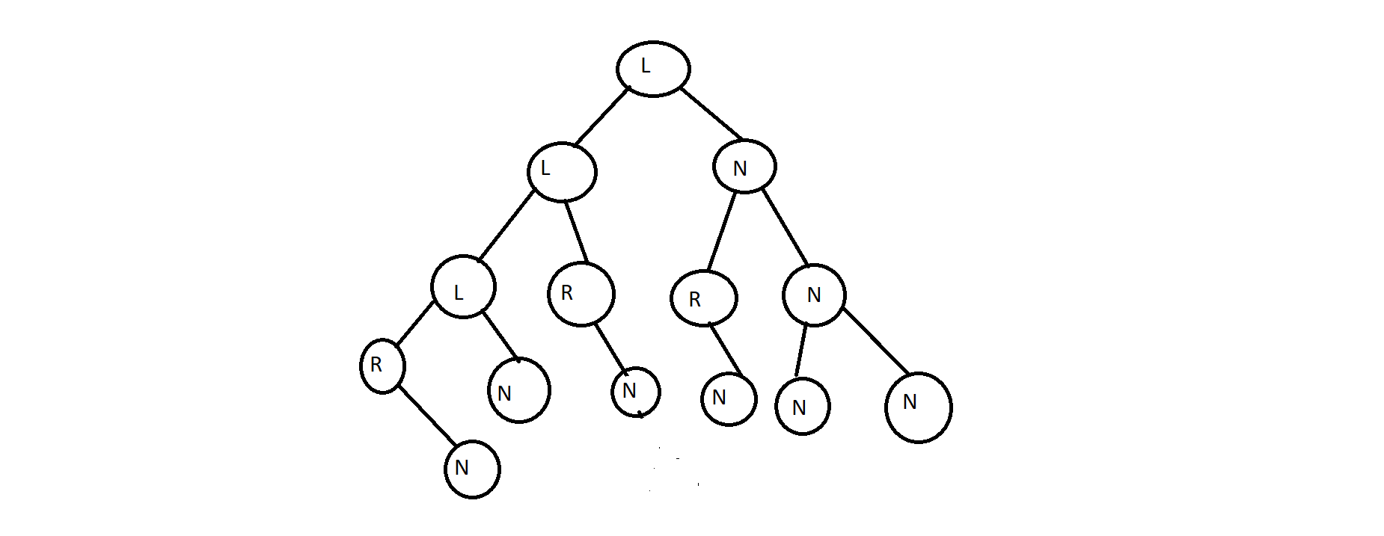
AVL Balance condition

Slide 14
Algorithm 3: AVL-Insert-Restore (T, x)
1.y ← π[x]
2. while y != ∅ AND Bal(y) ∈ {−1, +1}
do y ← π[y]
x ← π[x]
if y = ∅ OR Bal(y) = 0
then return
if Bal(y) = −2 then if Bal(x) = +1
then Right-rotate(T, x)
Left-rotate(T, y)
else if Bal(x) = −1
then Left-rotate(T, x)
Right-rotate(T, y)
Recompute heights for the nodes involved in rotations, as per the description before the rotate routines

Slide 15
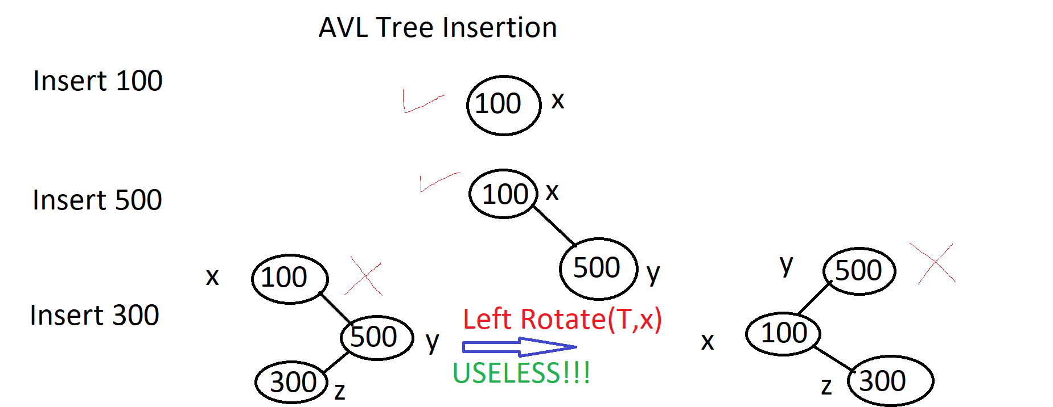
Demo: AVL Insert Sequence

Slide 16
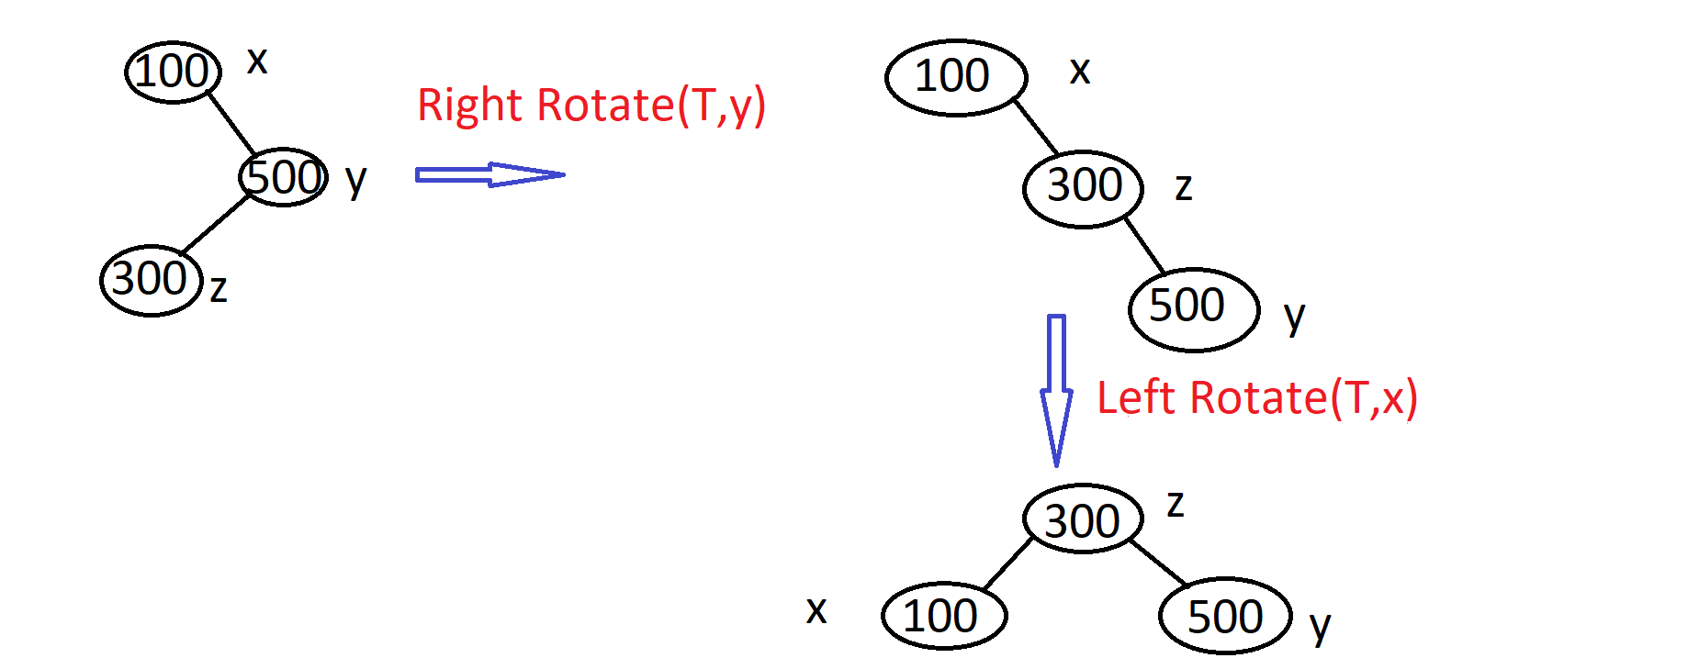
(continued)… Double Rotate Case

Slide 17
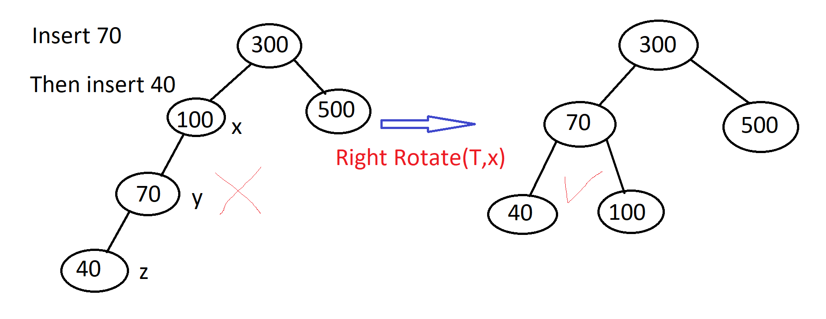
(continued…) Single Rotate Case

Slide 18
Different cases
When we encounter a deficit node (prior to insertion), along the path, we just terminate the algorithm.
When we encounter a surplus node (prior to insertion), along the path, we do a single or double rotation, according to the orientation of the last two links on the path, and then terminate.
If we encounter a balanced node (prior to insertion), along the path, we simply continue up the tree, with the height of that node being increased by 1.
The various cases corresponding to point 2 are shown in the figure on the next slide.

Slide 19
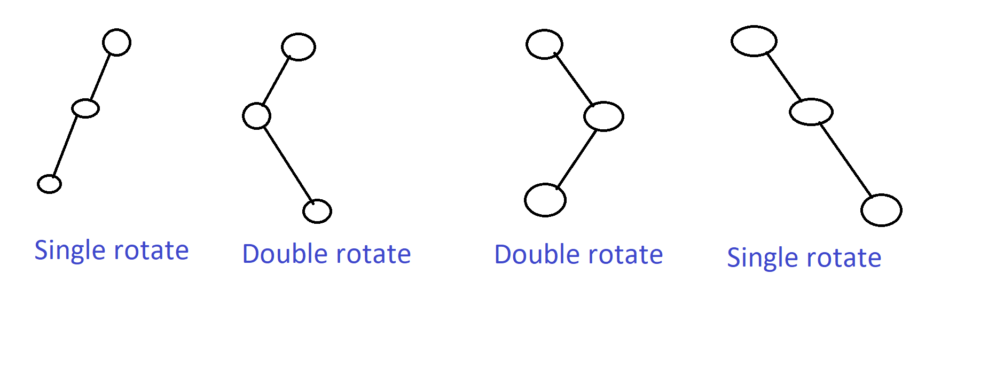
Cases for single/double rotation

Slide 20
AVL Delete cases
Deleting a leaf node
Deleting a node with exactly one child
Deleting a node with two children (replacement by successor/predecessor)
Thus, the node being deleted, is in effect a node of height at most 1

Slide 21
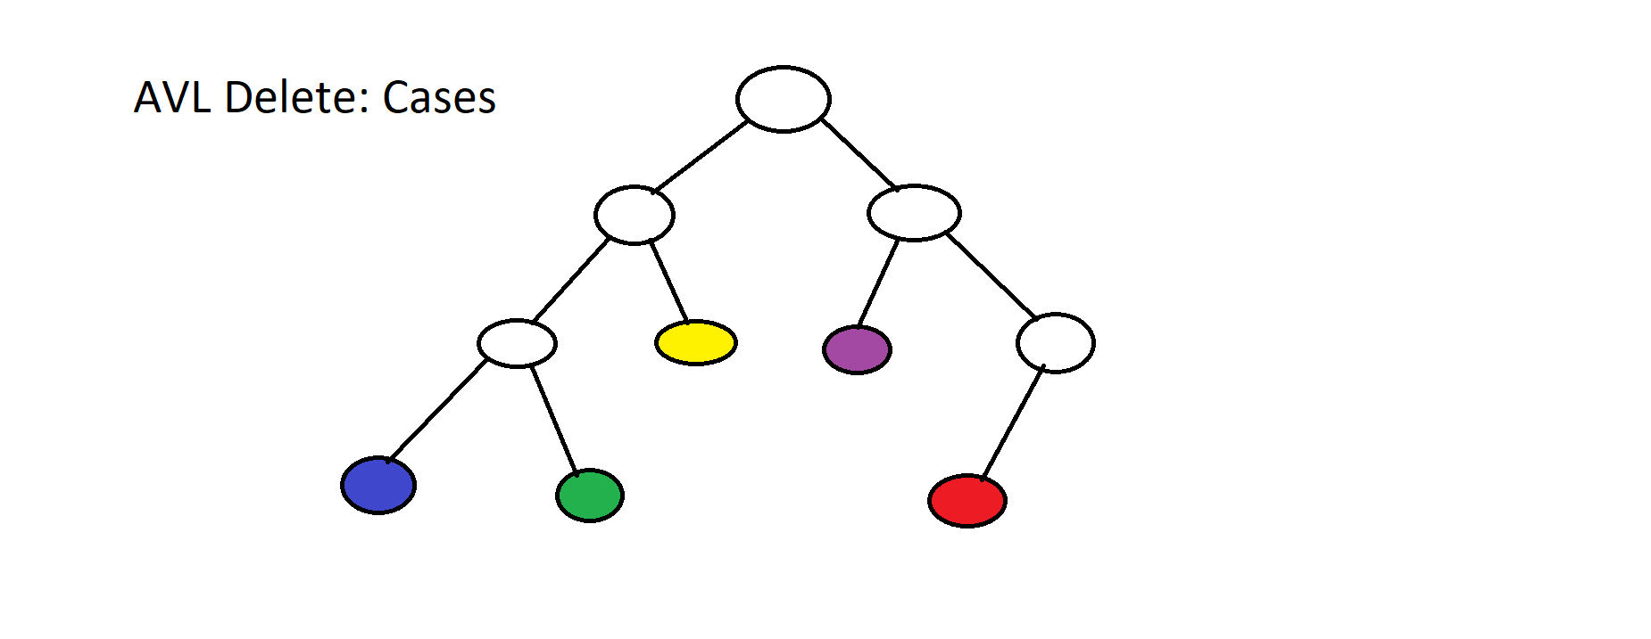
AVL Delete: terminating/propagating cases

Slide 22
Different cases
Deleting the blue or green node leads to immediate termination, since the parent node was balanced (prior to deletion)
Deleting the yellow node leads to the deficit case at its parent. However, its sibling is balanced, so we perform a single rotation to the right at its parent and the height of the parent node drops by 1, but it is AVL. We thus proceed up the tree removing AVL violations.
Deleting the red node corresponds to the surplus case, where we reduce the height of the parent which is now AVL and proceed to remove violations further up the tree
When we delete the violet node, the parent is a deficit node so we should rotate the parent node to the left. However, due to the opposite orientation of the sibling and its taller subtree, we need a double rotation: a right rotate at the violet node’s sibling and a left rotate at the violet node’s parent. The subtree is no AVL, with height reduced by 1, and we proceed up the tree to remove further violations.

Slide 23
Algorithm 4: AVL Delete Restore (T, x)
y ← π[x]
while y != ∅ AND Bal(y) !∈ {− 1, +1}
do if Bal(y) = +2
then if Bal(lef t[y]) = −1
then Left-rotate(T, left(y))
Right-rotate(T, y)
else if Bal(y) = −2
then if Bal(right[y]) = +1
then Right-rotate(T, right(y))
Left-rotate(T, y)
Recompute heights after rotation, for the nodes involved in the rotation if Rotation takes place then reassign the new root of that subntree to the variable y end if
y ← π[y] end while

Slide 24
Red-Black Trees
Every node is either red or black
If a node is red, both its hildren are black
The root is black
Leaves in this tree are always null pointers, and the leaves are black
Every root to leaf path has the same number of black nodes.
This number is the black height of the tree +1

Slide 25
B-Trees and 2,3,4-Trees
Why must a search tree have at most two children per node?
This is because we have one key value per node and we partition the descendants into those which are smaller and those which are bigger, than this key.
If we allow two keys in a node then we can arrange them in increasing order and partition the subtrees into three, with separator values being these keys.
Such a tree where there is a parameter t, is called a B-tree if everyroot-to-leaf path has the same height and
All nodes other than the root have at least t-1 keys and all nodes have at most 2t-1 keys
Each non-leaf node has exactly as many children as its number of keys +1 and separates the keys in its subtrees according to these key values.

Slide 26
2,3,4-Trees
A B-tree with parameter t=2 is a 2,3,4-tree. The reason is, every non-leaf node has either 2,3 or 4 children.
The idea behind this is that we want all leaves at same height, which is not possible for a binary search tree, as we might have arbitrary numbers of data records.
The flexible number of keys stored per node, helps B-Trees overcome this obstacle.

Slide 27
Splitting / merging nodes
When performing insertions, more keys accumulate in the existing nodes, until one of them hits capacity. When that is exceeded, the median key is sent up to the parent and the remaining keys are fragmented into two nodes, and the children are also shared among these equally. If the parent is full a further propagation takes place.
When deleting, the number of keys keeps diminishing and at some point a node might fall below the allowed threshold number of keys. In this case such a node borrows a key its successor or predecessor, else it merges with a sibling node and the new node has enough keys for a successful delete.
The root node has no lower bound on the threshold of keys and when it reaches zero keys the node is discarded and the tree’s height drops by 1..

Slide 28
A Red-Black Tree is basically a 2,3,4-tree in disguise
Recall that the root is black
If a node is red, then both its children are black
Alternatively, if a node is red, its parent is black
Every red node’s key can be moved up to its black parent
This results in zero red nodes, and all black nodes which have absorbed their red children’s key values, now can have more children as they have greater number of separator keys.
Since black-height of a red black tree is fixed across different paths, and we are merging the red nodes into black ones, all leaves are at the same level.

Slide 29
Red-Black trees are maintained by rotations
Although we wont go into it in detail, the red black trees have height O(log n), due to the properties.
The height is maintained upon insertion or deletion by rotations, much like they happen in AVL Trees.
These can be viewed as actions in 2,3,4-trees as explained earlier.
We end with pictures of Red-Black trees and 2,3,4-trees.

Slide 30
A 2,3,4-Tree, built using insertions

Slide 31
B Tree t=3
Insert demonstration

Slide 32
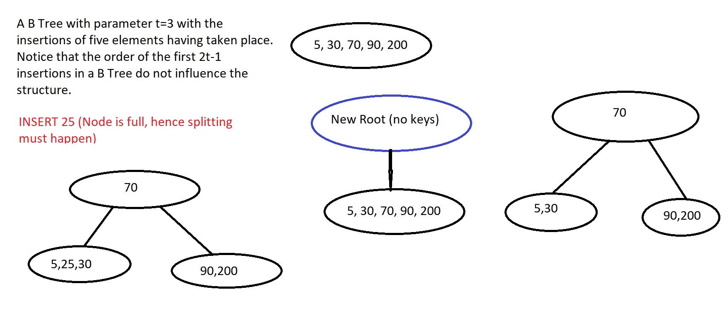

Slide 33
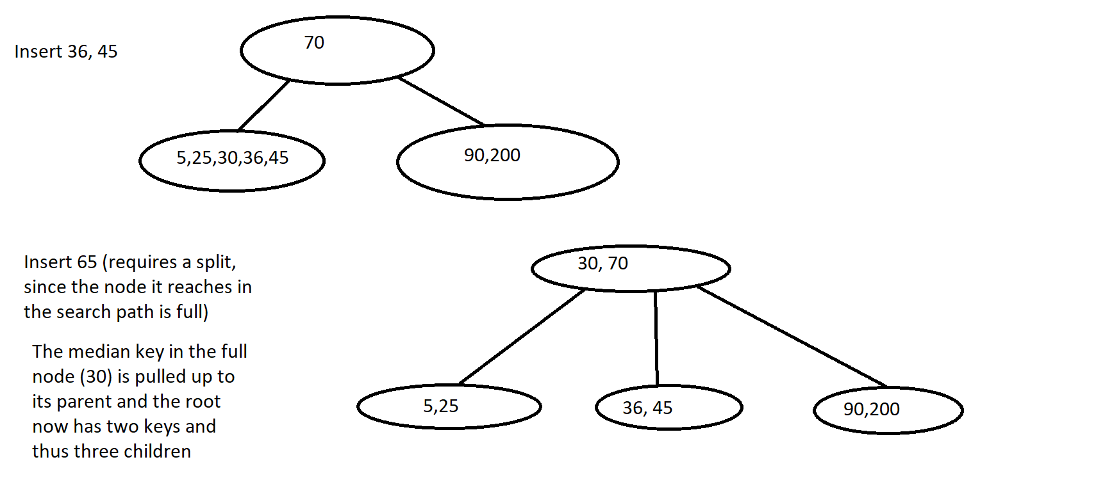

Slide 34
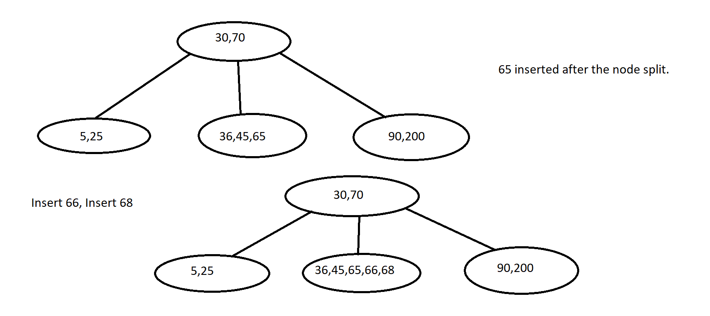

Slide 35
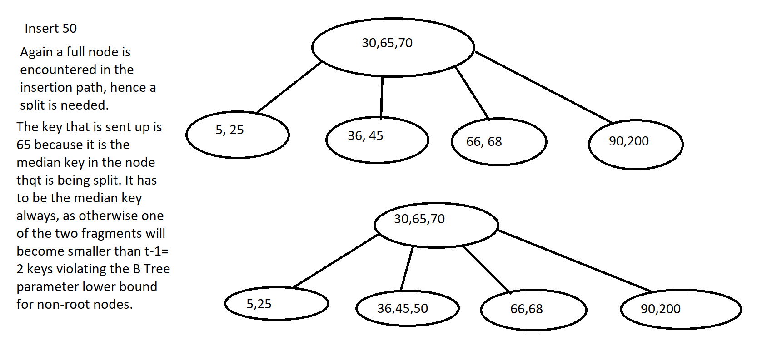

Slide 36
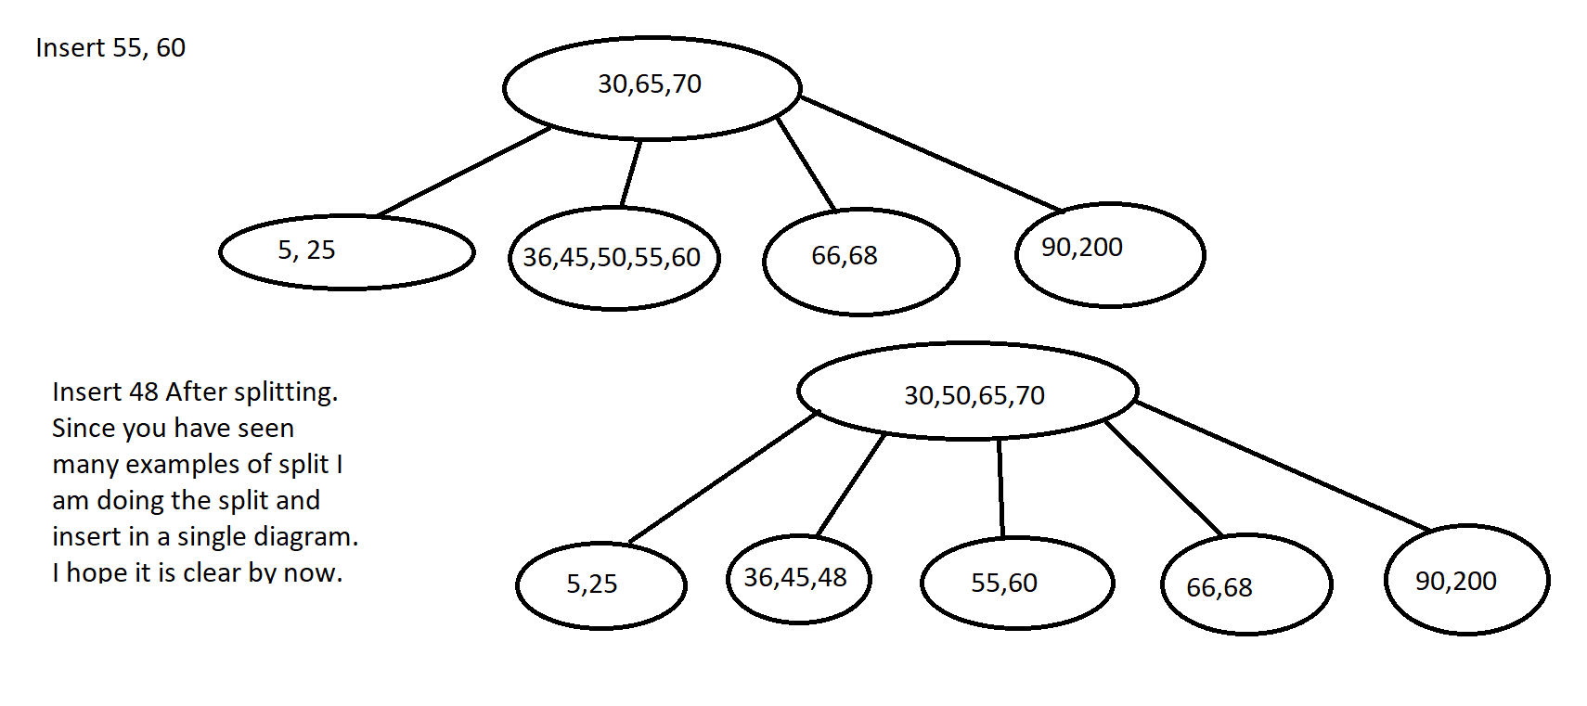

Slide 37
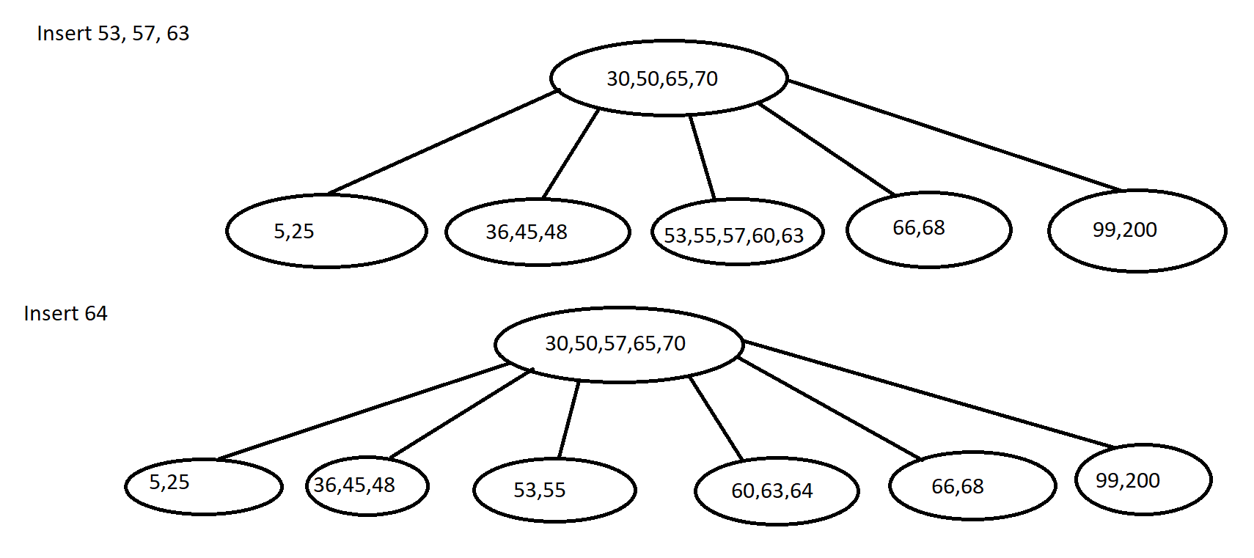

Slide 38
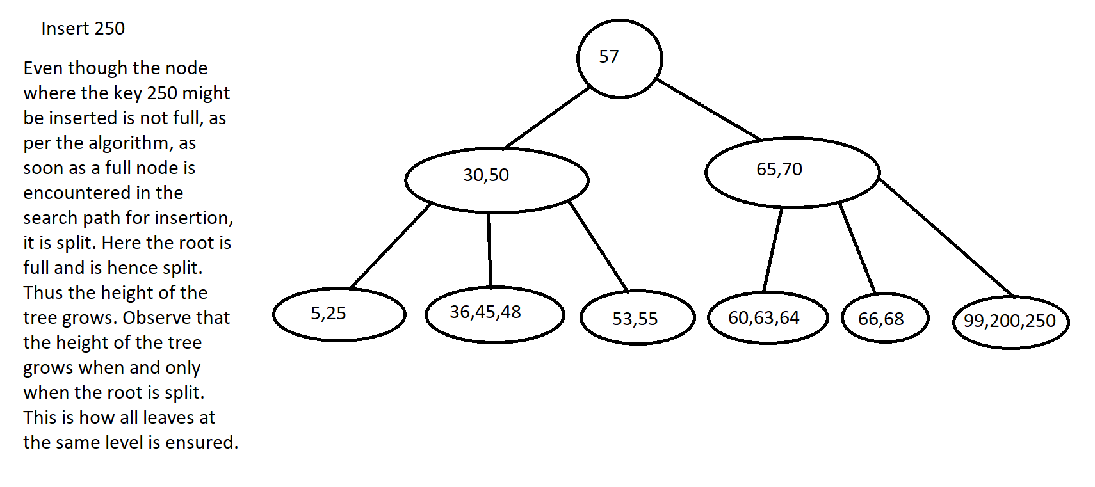

Slide 39
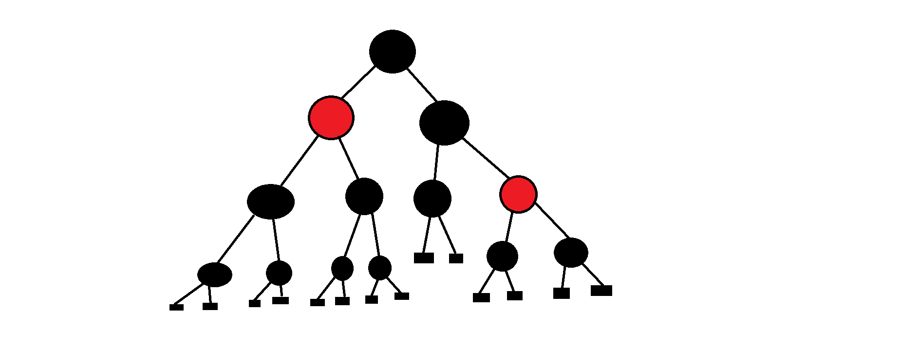
Red-Black Tree example

